Slide 1
Mathematics of Deep Learning Architectures
Iven Bai
Justin Fung
Vishant Raajkumar
Leo Xu
Daniel Wang
SEMS Symposium 2024
Carnegie Mellon University
Advisor: Junichi Koganemaru

Slide 2
Deep Learning architectures
Deep Learning is an umbrella term for a class of algorithms that have seen major applications in recent years
Aside from its obvious applications in areas such as data science, recently it has also been used in mathematical research to help researchers prove rigorous mathematical theorems

Slide 3
Example: blowup solutions to the Euler equations
A major open problem in mathematical fluid mechanics is finding blow-up solutions to the Euler equations with smooth initial data
In recent years, there have been attempts by multiple groups to run numerical simulations for Euler (and similar equations) to find numerical evidence of such solutions, and use the numerical evidence to motivate rigorous mathematical results

Slide 4
Example: blowup solutions to the Euler equations
In Luo-Hou ‘13 [1,2], the authors used traditional numerical methods to study 3D axisymmetric Euler with cylindrical boundary and found strong evidence of such solutions, however classical methods are costly (sometimes taking months on supercomputers) and tend to have issues close to singularity formation
In a recent paper Buckmaster, Gomez-Serrano, Lai, Wang ‘22 [3], the authors were able to overcome some of these challenges by training a Physics-informed neural network (PINN). Training required less than 24 hours on a local 40GB GPU.

Slide 5
Some advantages of neural networks vs classical numerical methods
Deep learning methods tend to scale well with respect to dimension and are usually mesh-free, whereas classical methods (e.g. finite elements for nonlinear PDEs) are usually costly for high dimensional and highly nonlinear problems. The significant speedup of deep learning methods make them an attractive alternative to classical numerical methods for certain tasks
Pretrained deep learning models are readily available and are constantly being updated, and PyTorch (framework for designing NN models) is highly customizable
However, deep learning models can be difficult to interpret and can suffer from issues with overfitting and poor generalization, due to the increasing complexity of the models (bias-variance tradeoff)

Slide 6
Our work
Investigated the mathematical principles that underlie prototypical deep learning architectures
Performed numerical experiments to examine the performance of deep learning models
In our first case study, we showed numerically that deep learning-based methods outperformed traditional autoregressive models on time series data
In our second case study, we developed a PINNs framework using PyTorch to generate approximate solutions to PDEs with various kinds of BCs

Slide 7
Mathematics of Deep learning Architectures

Slide 8
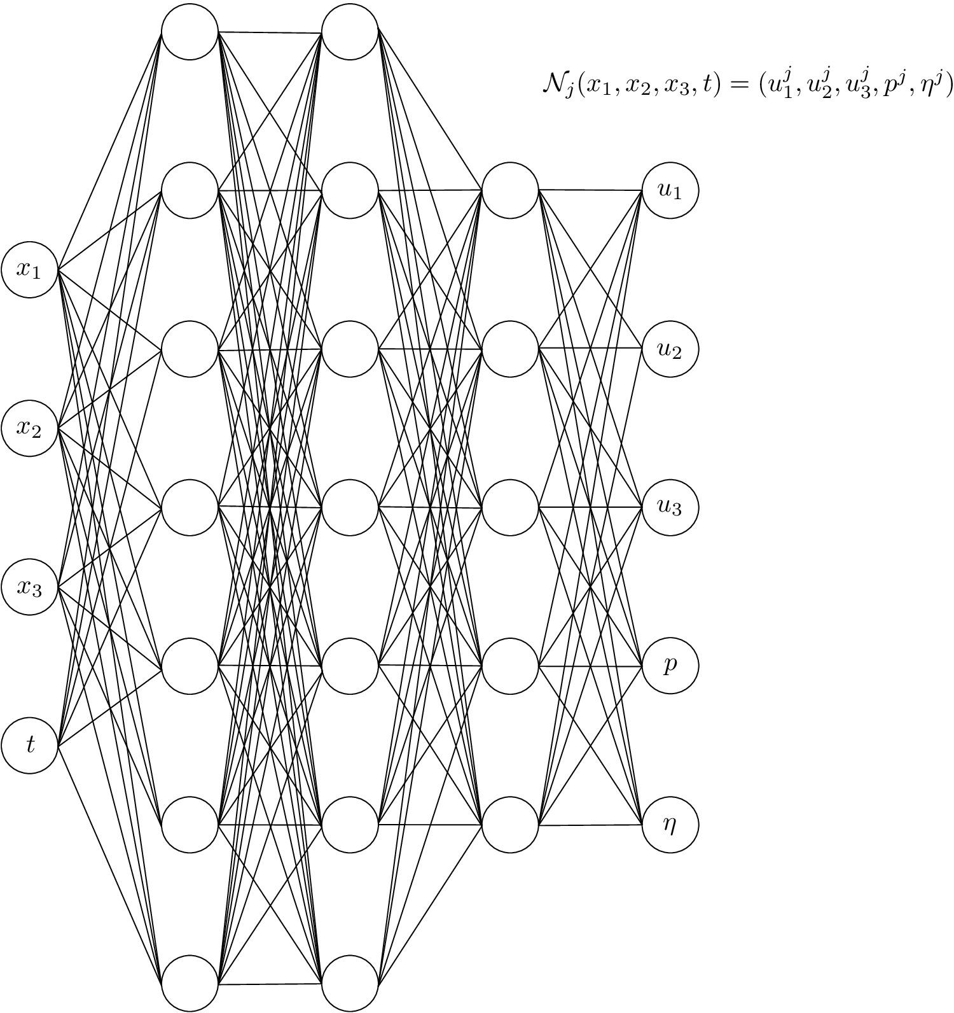
Feedforward neural networks
A feedforward neural network is a composition function f: ℝ^{n}→ℝ^{m} defined via f = f^{(L)}○ f^{(L-1)} ○…○f⁽²⁾○f⁽¹⁾
The layers {f^{(l)}}_{l=1}^{L} are maps f^{(l)}: ℝ^{d^{l-1}}→ℝ^{d^{l}} of the form ɸ^{(l)}(W^{(l)}x+b^{(l)}), where W^{(l)} is a matrix of weights, b^{(l)} is a vector of biases, and ɸ^{(l)} is a so-called activation function at layer l, where 1≤l≤L.

Slide 9
Feedforward neural networks
Given an input x ϵ ℝ^{d^(0)}, the signal s^{(l)} and activation x^{(l)} at layer l are the quantities s^{(l)} = W^{(l)}x^{(l-1)}+b^{(l)} and x^{(l)} = ɸ^{(l)}( s^{(l)} )
The activation functions are what distinguishes a neural network from a standard regression model: nonlinear activation functions allows neural networks to approximate nonlinear functions
Standard activation functions: ReLU(x) = max(x,0), sigmoid, etc.

Slide 10
Optimization framework
Neural networks are associated with a scalar loss or cost function C, which is a function of the weights and biases that determine the model. Typically the cost function is based on the negative log-likelihood
Most commonly used loss function is the l²-error between the NN output and the target training data, though more interesting loss functions (e.g. adding regularization terms) are sometimes used
The main goal of deep learning algorithms is to design efficient architectures to minimize the specified loss function

Slide 11
Optimization framework
The most popular approach is to use Gradient-based methods (e.g. stochastic gradient descent)
In order to update the parameters at each epoch, one needs to compute the gradient vector ∇C = (∇C_{W},∇C_{B}) containing the partial derivatives w.r.t. to the weights and biases
For efficient computation, in practice one uses the backpropagation algorithm, which is a special case of reverse-mode autodifferentiation (method distinct from symbolic differentiation and numerical differentiation with finite differences)

Slide 12
Equations governing feedforward neural networks
Assuming C is the ½ the l²-loss, one can derive the following set of master equations (in matrix form) for a feedforward NN. For notational convenience, we define δ_{j}^{(l)} = ∂C/∂s_{j}^{(l)}
X^{(l)} = ɸ((W^{(l)})^{T}X^{(l-1)}-B^{(l)}) , 1≤l≤L
δ^{(L)} = (x^{(L)} - z) ⊙ɸ’(s^{(L)})
δ^{(l-1)} = W^{(l)} δ^{(l)}⊙ɸ’(s^{(l-1)}), 1≤l≤L
∂C/∂W^{(l)} =X^{(l-1)}(δ^{(l)})^{T}, 1≤l≤L
∂C/∂B^{(l)} = -δ^{(l)}, 1≤l≤L
Here ⊙ is the Hadamard product of two vectors in ℝ^{n}, defined via (u⊙v)_{i} = u_{i} v_{i}

Slide 13
Equations governing feedforward neural networks
X^{(l)} = ɸ((W^{(l)})^{T}X^{(l-1)}-B^{(l)}) , 1≤l≤L
δ^{(L)} = (x^{(L)} - z) ⊙ɸ’(s^{(L)})
δ^{(l-1)} = W^{(l)} δ^{(l)}⊙ɸ’(s^{(l-1)}), 1≤l≤L
∂C/∂W^{(l)} =X^{(l-1)}(δ^{(l)})^{T}, 1≤l≤L
∂C/∂B^{(l)} = -δ^{(l)}, 1≤l≤L
The first equation is a forward recursive formula of the output of the NN (forward pass)
The second/third equations are the backpropagation formulas for the deltas (backward pass) Key observation as to why backpropagation provides a speedup in runtime: the signals s^{(l)} are computed during the forward pass and can be stored, so recomputation is not necessary during the backward pass
The last two equations provide the formula for the gradient given the deltas
For a different cost function C, only the second and third equations for the deltas change

Slide 14
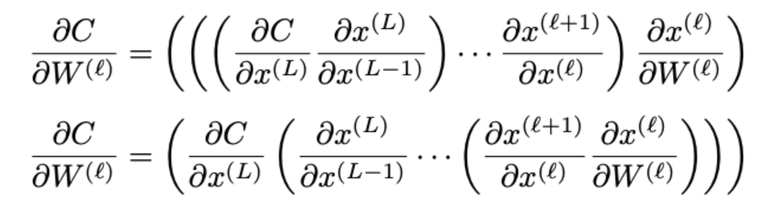
Alternative view of backpropagation
Another way to understand the speedup from backpropagation is by comparing different orderings in computing ∂C/∂W^{(l)}:
A simple counting argument shows that the first ordering (which represents computing the gradients backwards from the last layer) is faster than the second ordering by an order of p^{(l)}, the number of parameters in the l-th layer

Slide 15
Overview of mathematical literature on deep learning
Universal approximation theorems - density-type results giving theoretical guarantees for classes of neural networks to be dense in some given functional class (e.g. C^{k}, Hölder, L^{p} , Sobolev, etc)
Cybenko ‘89 [4], Hornik et. al. ‘91 [5] establishes this for C(K), K compact
Barron ‘93 [6] for L²(ℝ^{n}), Mhaskar-Micchelli ‘92 [7] for L^{p} (ℝ^{n})
Shen-Yang-Zhang ‘20 [8] for Sobolev spaces W^{k,p}(K), K compact
However, these theorems do not guarantee that the training algorithms will be able to identify the desired neural network approximations, only that they exist
Allen-Zhu, Li, Song ‘19 [9] proves a polynomial-time bound for overparameterized NNs

Slide 16
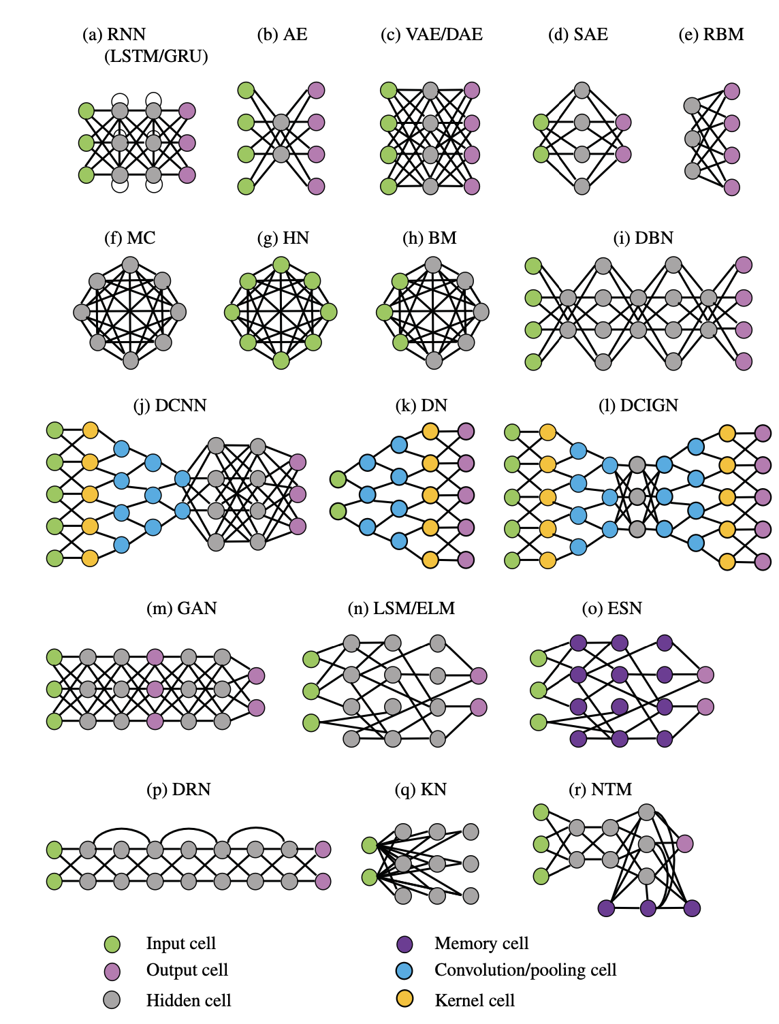
Overview of mathematical literature on deep learning
Obtaining quantitative bounds under general conditions is an active area of research
Designing task-specific NNs architectures is also an active area of research both in academia and industry; see diagram on the right from Brunton-Kutz [10]

Slide 17
Case Study I: Time Series Data

Slide 18
Case study: LSTM vs SARIMA on time series data
Motivation: we want to understand how popular deep learning models perform relevant to classical models used in practice
We studied time-series data coming from finance markets and trained an LSTM model vs a SARIMA (seasonal autoregressive integrated moving average model)

Slide 19
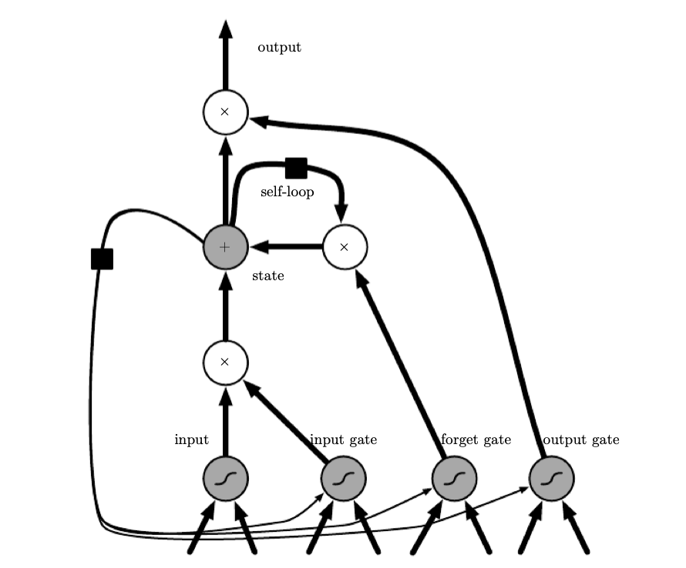
LSTM (Long short-term memory)
Subclass of RNN (recurrent neural network) models for sequential data introduced in Hochreiter-Schmidhuber ‘97 [11]
LSTMs represent a popular class of deep learning models used in time series forecasting, including stock price prediction and weather forecasting
Diagram of LSTM “cell” from Goodfellow et al. [12]

Slide 20
Seasonal autoregressive integrated moving average models (SARIMA)
Moving average MA(q) models express the values of a time series as a linear combination of lagged independent normally distributed errors: y_{t} = ε_{t} + ɑ₁ ε_{t-1}+ ɑ₂ ε_{t-2}+ … + ɑ_{q} ε_{t-q}, ε_{t}~N(0,σ²)
Autoregressive AR(p) models express the values of a time series as a linear combination of prior values plus an error term: y_{t} = ε_{t} + β₁ y_{t-1}+ β₂ y_{t-2}+ … + β_{p} y_{t-p} +ε_{t} , ε_{t}~N(0,σ²)
Combining AR(p) and MA(q) gives an ARMA(p,q) process
ARIMA(p,d,q) models is useful for non-stationary models, where the process satisfies (1-ɑ₁B - … - ɑ_{p}B)(1-B)^{d}y_{t} = (1+β₁B + … + B^{q})ε_{t}. B is the backshift operator that takes a time series t →y_{t} to the backshifted time series t →y_{t-1}. d is a parameter chosen so that the differenced time series appears stationary
SARIMA models generalize ARIMA models and are a class of popular models used in time series forecasting

Slide 21
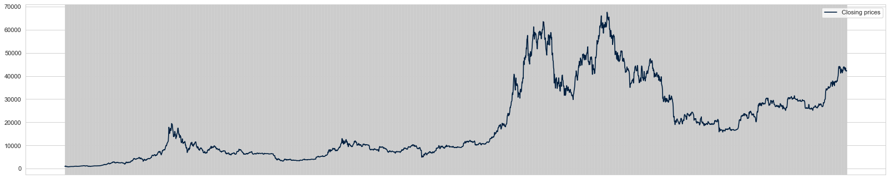
Data
We analyzed Bitcoin data from July 2019~July 2024
90% of the data is used for training and 10% of the data is withheld for validation

Slide 22
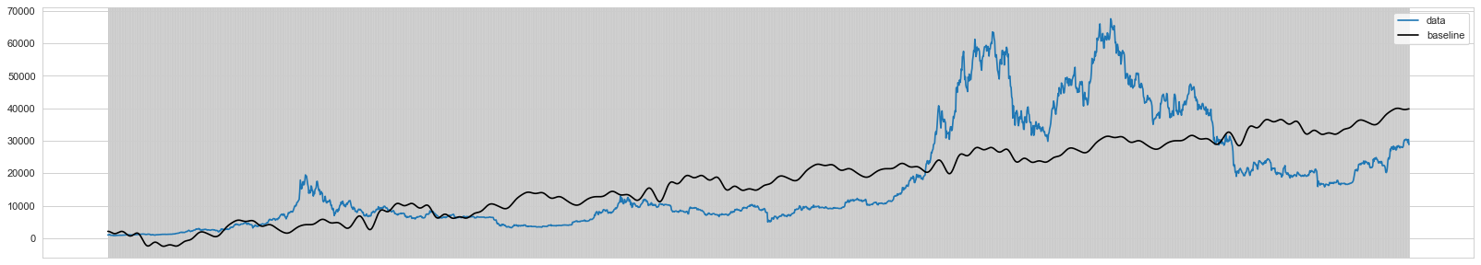
Baseline model: linear regression
For a naive baseline, we used a linear model fitting a linear combination of affine and sin/cos functions of different frequencies
Needless to say, the linear model fails to accurately capture the trend in the data

Slide 23
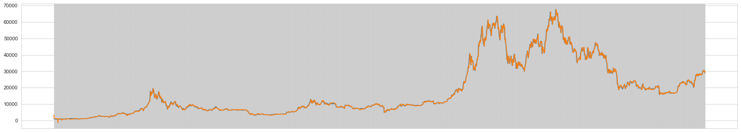
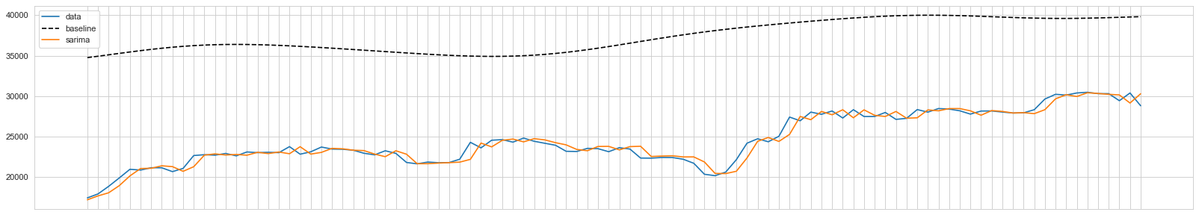
We then fit a 14 period SARIMA model (14 is a guess by plotting the rolling averages), which performed significantly better
The model took ~20 seconds to fit and MSE is around 2x10⁷ on validation data. By contrast, MSE with the regression baseline is close to 1x10⁸
Last plot is over the last 100 data points in the training data

Slide 24
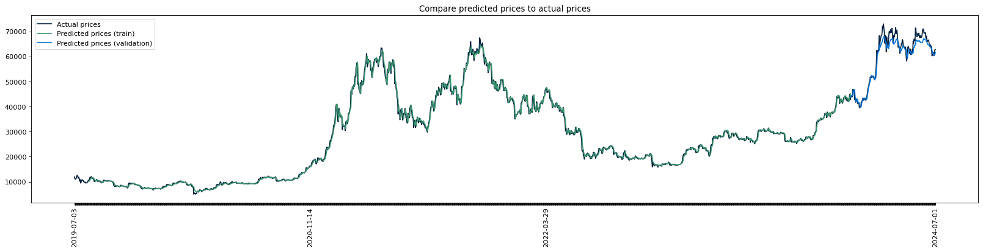
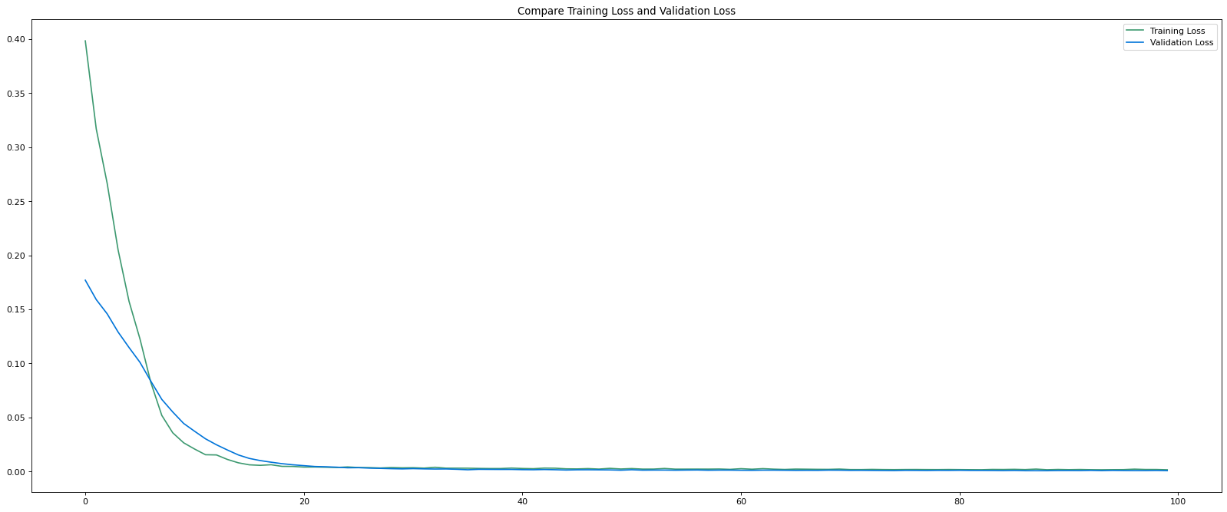
We then trained a very simple 2-layer LSTM model to see how it compares
After 100 epochs (runtime only ~1min), the MSE decreased by 99.4%. Final MSE on validation data is around 5x10⁶, compared to 2x10⁷ of the SARIMA model
Bitcoin prices are on a magnitude of 10⁵

Slide 25
Conclusions and future work
Our numerical experiment shows that the simple LSTM is more accurate than the classical alternatives
For immediate future work, we would like to train/validate more sophisticated LSTM model on more diverse time-series data to demonstrate their robustness

Slide 26
Case Study II: Physics-Informed Neural Networks

Slide 27
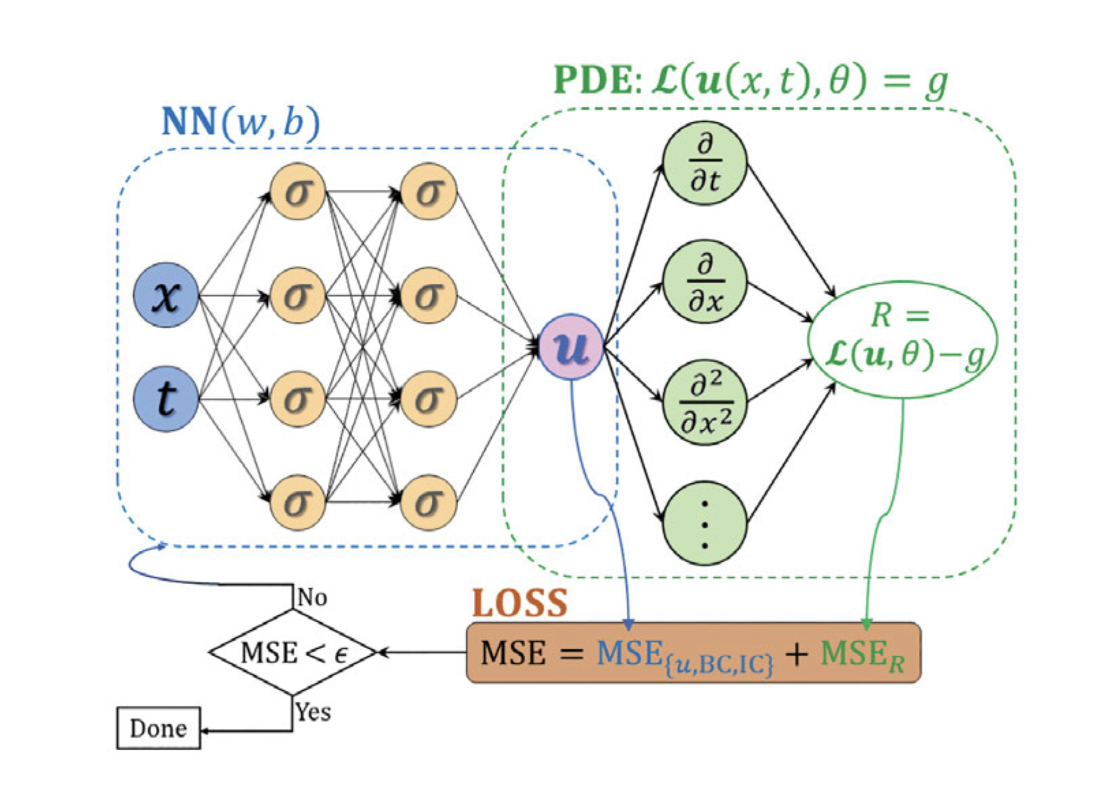
Physics-informed Neural Networks (PINNs)
In recent years there has been significant interest in using PINNs (first introduced in Raissi-Perdikaris-Karniadakis ‘19 [13]) for studying nonlinear PDEs (e.g. Buckmaster et al. [3])
The main idea is to incorporate additional loss terms coming from the PDE/boundary conditions/initial conditions in the loss function
Derivatives used for computing the PDE residual are computed using autodifferentiation
Diagram from Brunton-Kutz [10]

Slide 28
PINNs for PDEs
Motivation: we want to understand how PINN performs for approximating solutions to PDEs, gradually building a PINN model that can be used for studying nonlinear PDEs with nontrivial boundary conditions

Slide 29
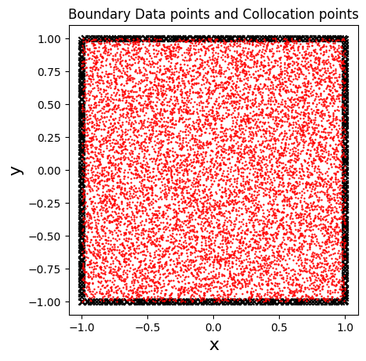
Case study: linear equation, 2D Laplacian with Dirichlet BC
Equation is -Δu = -(u_{xx}+u_{yy}) = 0 over [0,1]²
BC is u(0,y) = -y², u(1,y) = 1-y², u(x,0) = x², u(x,1) = x²-1
Explicit solution (ground truth) is u: [0,1]² →ℝ defined via u(x,y) = x²-y²
We used a simple NN with only linear layers and sigmoid activation
The loss function is a sum of MSE based PDE loss (computed at the collocation points) and BC loss (computed at the boundary points). We found that randomized collocation points improves model performance significantly
A separate set of coordinates are withheld to be used for validation

Slide 30
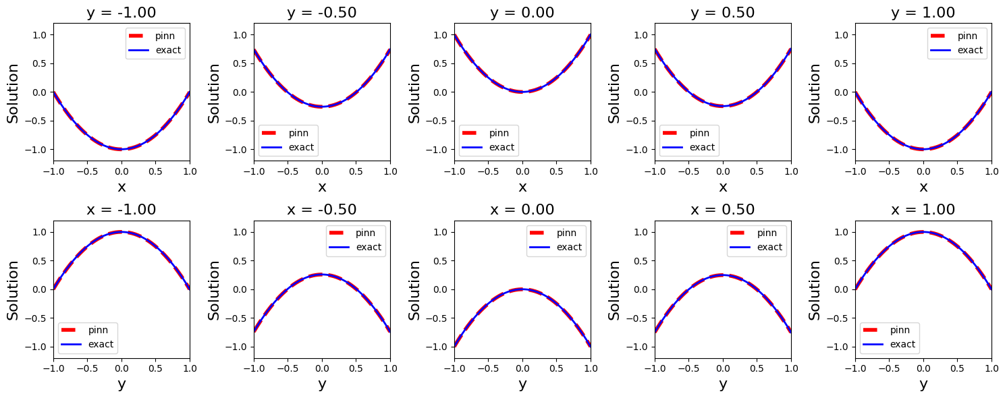
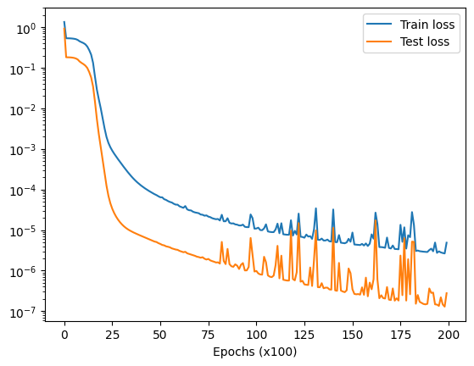
Training took around 8 minutes for 20k epochs
On the validation coordinates, the model achieved a MSE loss of 3x10⁻⁶. This is likely due to the fact that the equation is linear and the BCs are simple

Slide 31
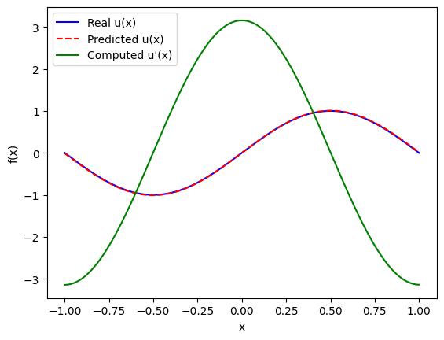
Case study: 1D Poisson with periodic BC
We also tried the same PINN model on the 1D Poisson equation with periodic boundary conditions
The model performed equally well and training only took around 30 seconds

Slide 32
Case study: 2D Poisson with mixed BC
Equation is -Δu = 8𝛑² sin(2𝛑x)cos(2𝛑y) over [0,1]²
BC is mixed: periodic BC on left/right, u(0,y) = u(1,y), homogeneous Dirichlet on bottom, u(x,0) = 0, Neumann on top, ∂u/∂n (x,1) = 2𝛑 sin(2𝛑x)
Explicit solution is u: [0,1]² →ℝ defined via u(x,y) =sin(2𝛑x)sin(2𝛑y)
The more complicated BCs are motivated by more realistic BCs coming from the free boundary incompressible Navier-Stokes equations in 2D

Slide 33
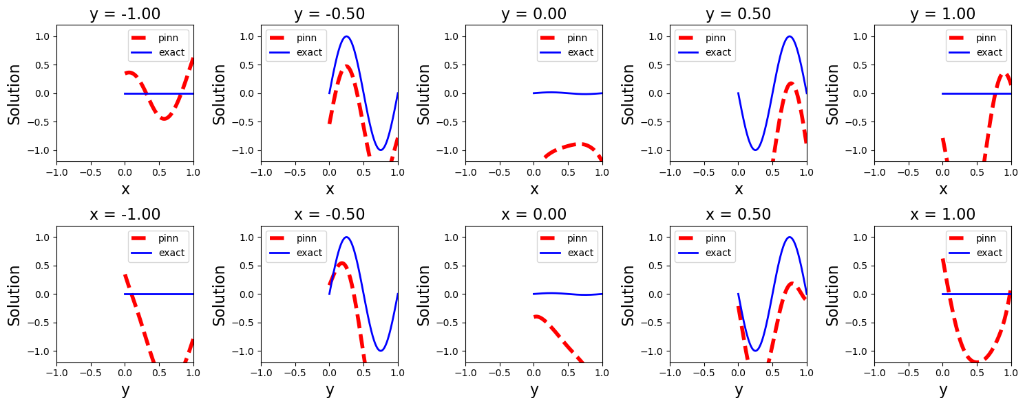
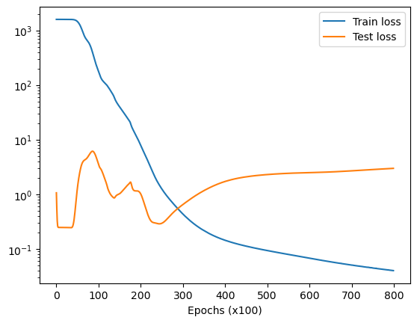
With more complicated BCs, we found that the same PINN model had a tendency to overfit, which is fairly typical of NNs
Model accuracy was also fairly poor, as evident in the graph above

Slide 34
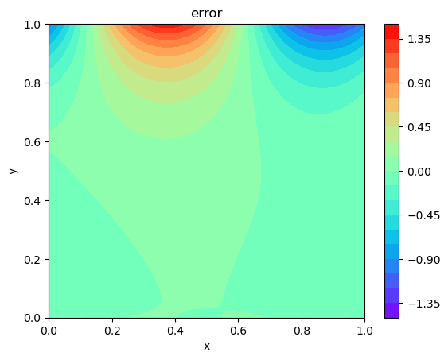
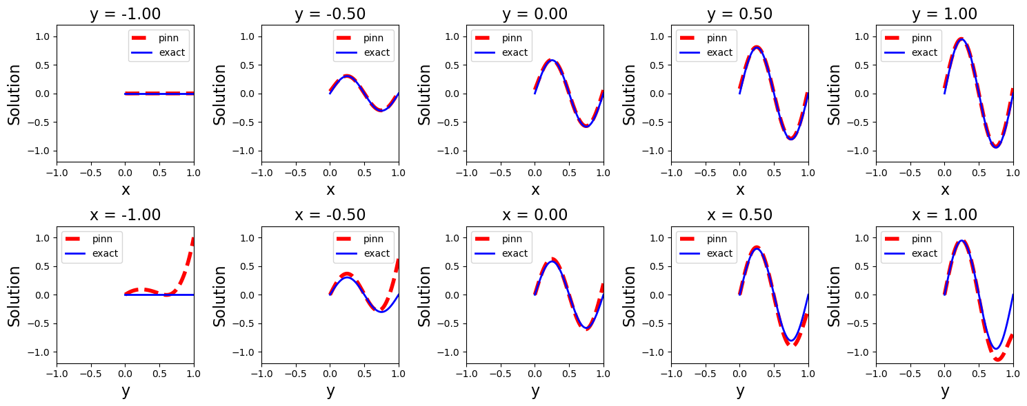
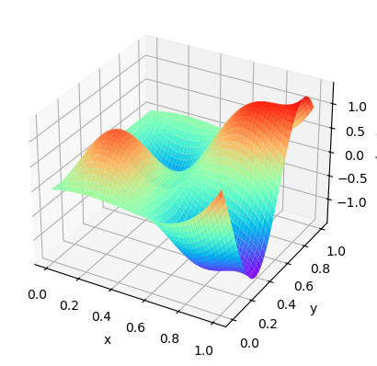
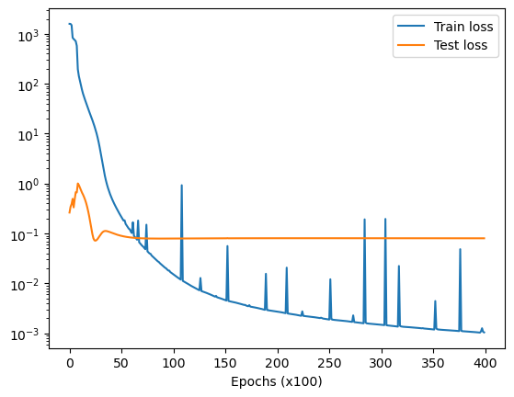
We incorporated various techniques to improve model performance, including
Increasing depth and width of NN
Adding dropout layers
Adding weights to loss function
Adding regularization to optimizer
While model performance improved, model still overfits and accuracy remains undesirable
We suspect that the problem comes from enforcing the Neumann BC at the top

Slide 35
Conclusion and future work
Our simple PINN architecture can accurately approximate solutions to simple linear PDEs and BCs
We are currently attempting to improve model performance for more complicated BCs by trying other techniques, including incorporating more complicated derivative information in the loss function (e.g. Sobolev training)
Since NNs are sensitive to hyperparameters, we are also trying to incorporate a hyperparameter tuning framework (Optuna) for identifying optimal parameters
Our PINNs experiments show that while deep learning algorithms are extremely powerful, they can still be prone to failure and NN architectures need to be carefully engineered and validated to be useful for sufficiently complicated tasks
Our goal is to eventually build a robust PINN model for approximating solutions to nonlinear PDEs with similar BCs (e.g. free boundary Navier-Stokes)

Slide 36

Thank you for your attention!
Code and data available on Github: https://github.com/jkoganem/SEMS2024-deeplearning

Slide 37
References
[1] G. Lou, T. Hou, Potentially singular solutions of the 3D axisymmetric Euler equations. [2] G. Lou, T. Hou, Toward the Finite-Time Blowup of the 3D Axisymmetric Euler Equations: A Numerical Investigation. [3] T. Buckmaster, J. Gómez-Serrano, C. Lai, Y. Wang, Asymptotic self-similar blow-up profile for three-dimensional axisymmetric Euler equations using neural networks. [4] G. Cybenko, Approximation by Superpositions of a Sigmoidal Function. [5] K. Hornik, Approximation capabilities of multilayer feedforward networks. [6] A. R. Barron, Universal approximation bounds for superpositions of a sigmoidal function. [7] H. N. Mhaskar, C. Micchelli, Approximation by superposition of sigmoidal and radial basis functions. [8] Z. Shen, H. Yang, S. Zhang, Deep network approximation characterized by number of neurons. [9] Z. Allen-Zhu, Y. Li, Z. Song, A convergence theory for deep learning via over-parameterization. [10] S. L. Brunton, J. N. Kutz, Data-Driven Science and Engineering: Machine Learning, Dynamical Systems, and Control. [11] S. Hochreiter, J. Schmidhuber, Long Short-Term Memory. [12] A. Courville, I. Goodfellow, Y. Bengio, Deep Learning. [13] M. Raissi, P. Perdikaris, G. E. Karniadakis, Physics-informed neural networks: A deep learning framework for solving forward and inverse problems involving nonlinear partial differential equations.

Slide 38
Team members
Iven Bai
Junior
Research interests: Discrete and continuous time finance
Currently looking for finance industry opportunities
Linkedin: https://www.linkedin.com/in/huab/
Justin Fung
Sophomore
Research interests: Machine Learning
Currently pursuing research/industry opportunities in machine learning
Linkedin: linkedin.com/in/justinfung17/
Vishant Raajkumar
Junior
Research interests: Machine Learning, Computer Graphics
Currently looking for research and industry opportunities
Linkedin: linkedin.com/in/vishant-raajkumar
Leo Xu
Junior
Research interests: Mathematical Finance
Currently looking for finance industry opportunities
Linkedin: www.linkedin.com/in/xu-leo
Daniel Wang
Junior
Research interests: Combinatorics, Formal verification
Currently pursuing research/industry opportunities
Github: github.com/danielwang546

